Slide 1
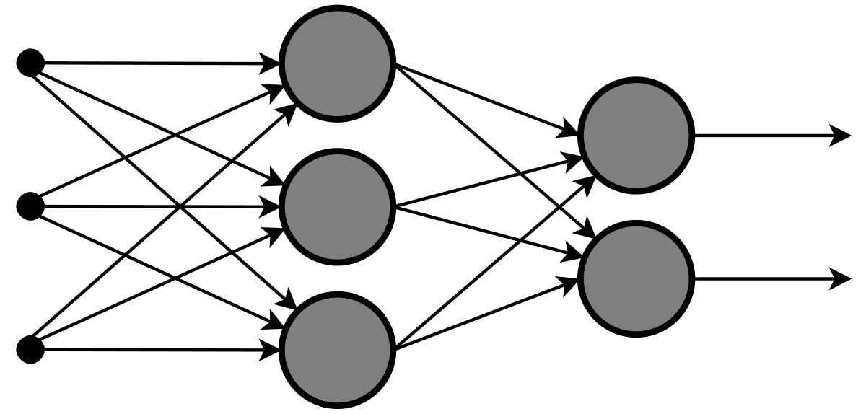
VATLD: A Visual Analytics System to Assess, Understand and
Improve Traffic Light Detection
Paweł Flis
Karol Krupa
Ali Amir

Slide 2
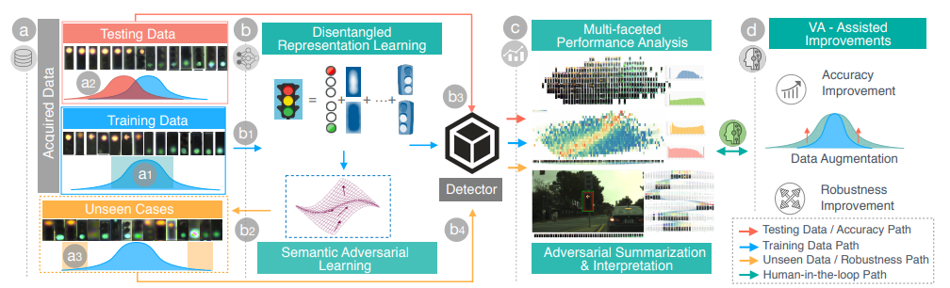
Framework

Slide 3
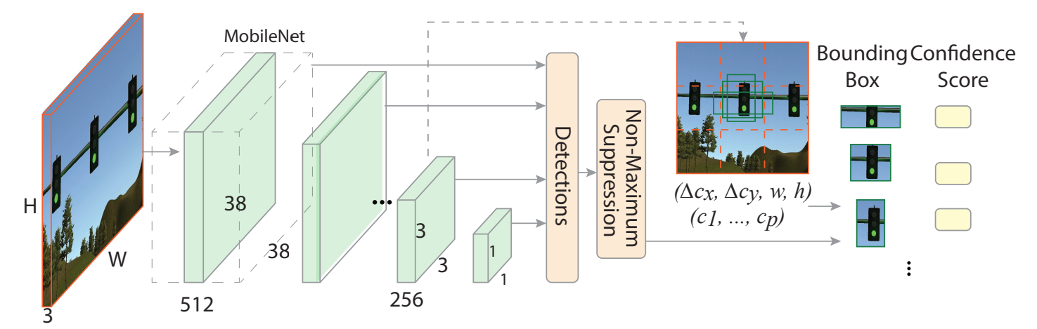

Network Visualisation

Slide 4
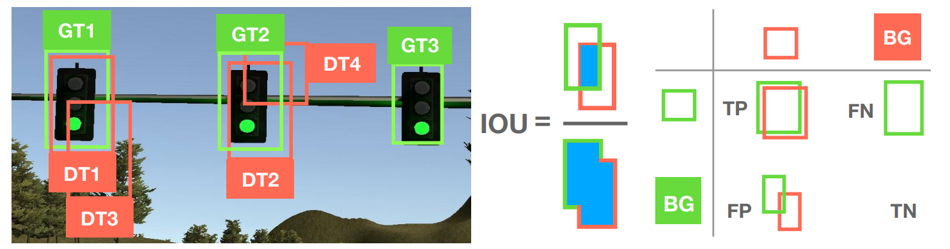
Assessing the performance

Slide 5
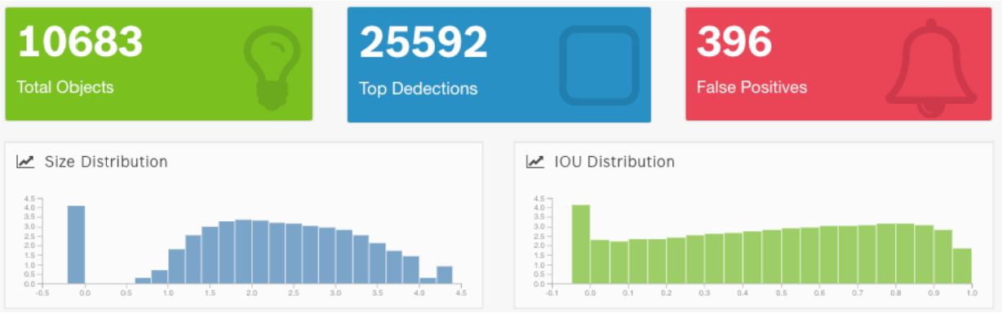
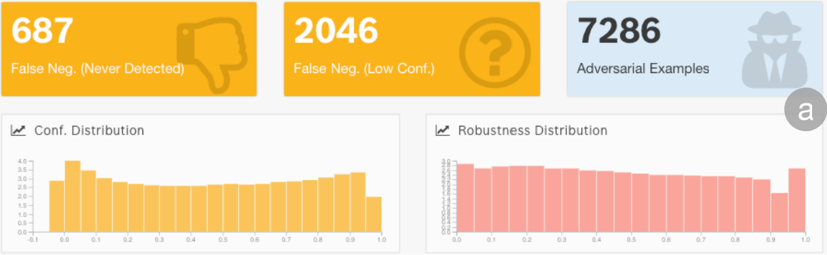
Data characteristics

Slide 6
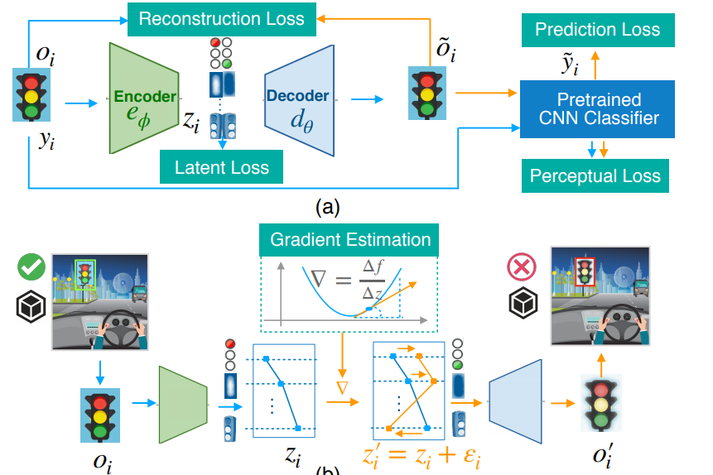

Data augmentation and adversarial attacks
Disentangled representation learning
Semantic adversarial learning

Slide 7
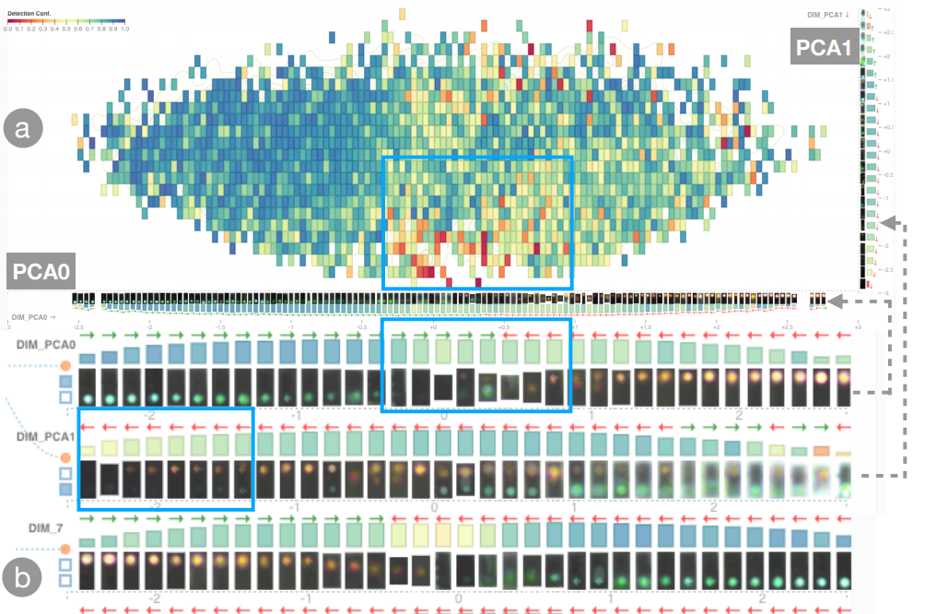
Feature extraction

Slide 8
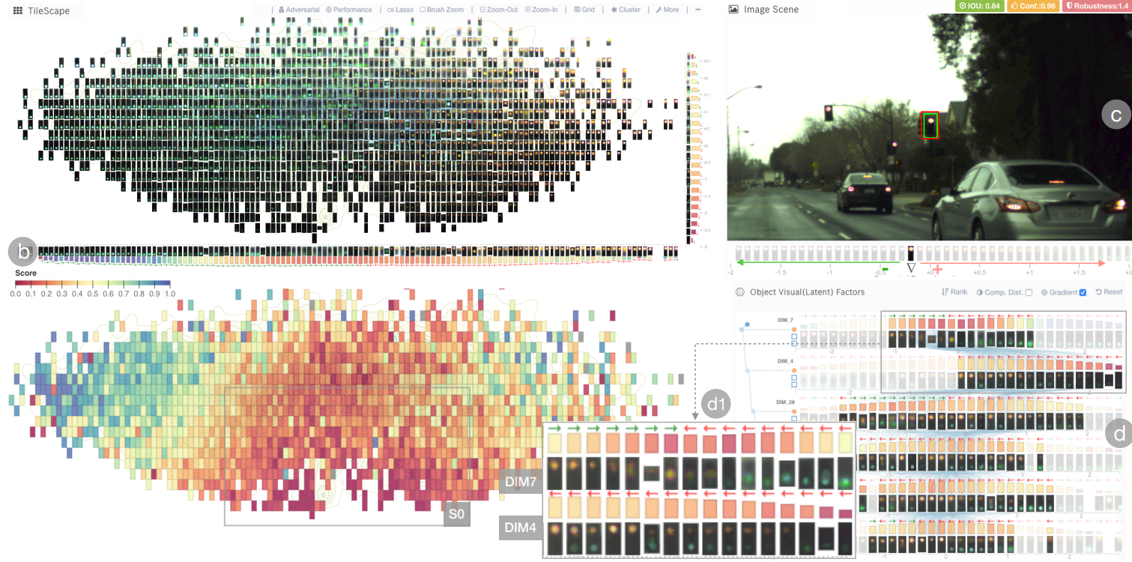
Aggregation and visualization

Slide 9
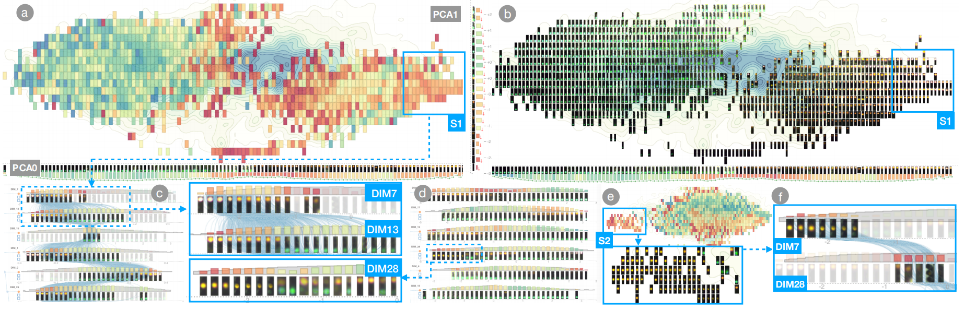
Analyzing test results

Slide 10
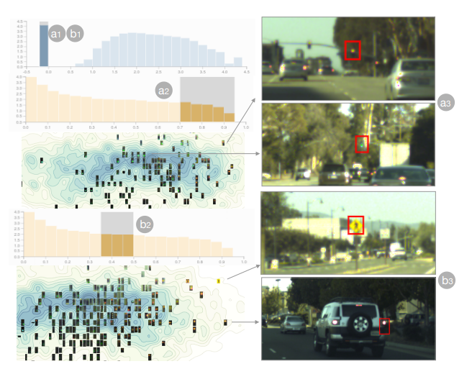
Pinpointing errors

Slide 11
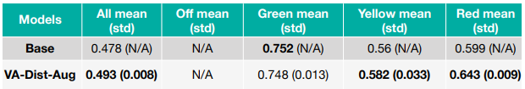
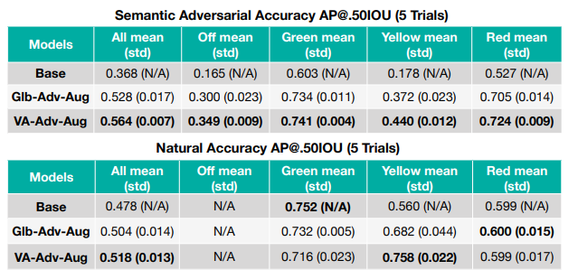
Results

Slide 12
THE END
Thank you!

